Slide 1
Quiz 1
13162 – The digit board problem

Slide 2
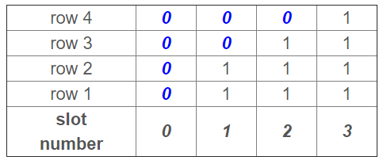

Slide 3
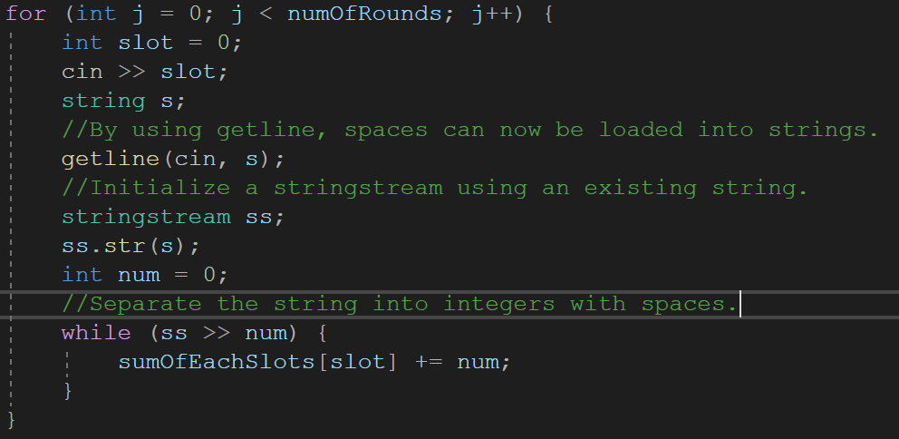
Implementation
A dynamically allocated array, whose size is L, storing each slot’s sum

Slide 4
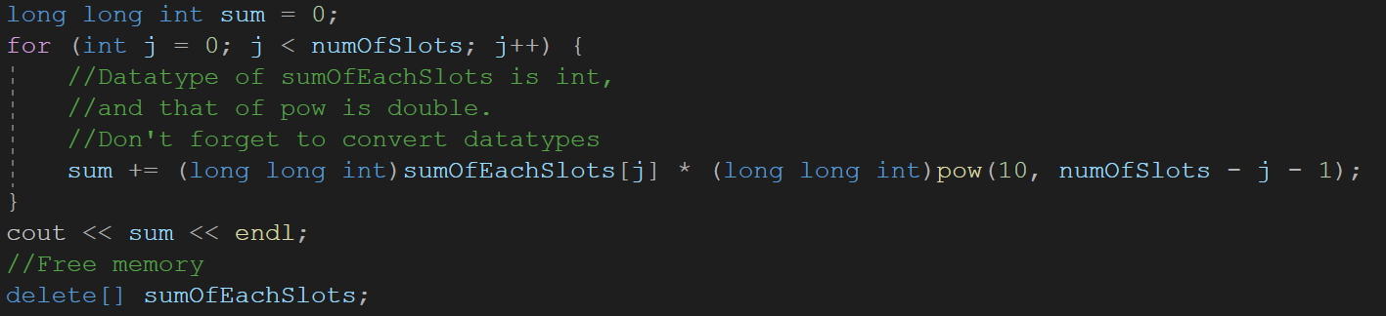
Implementation
Add up every slots’ sum in the end

Slide 5
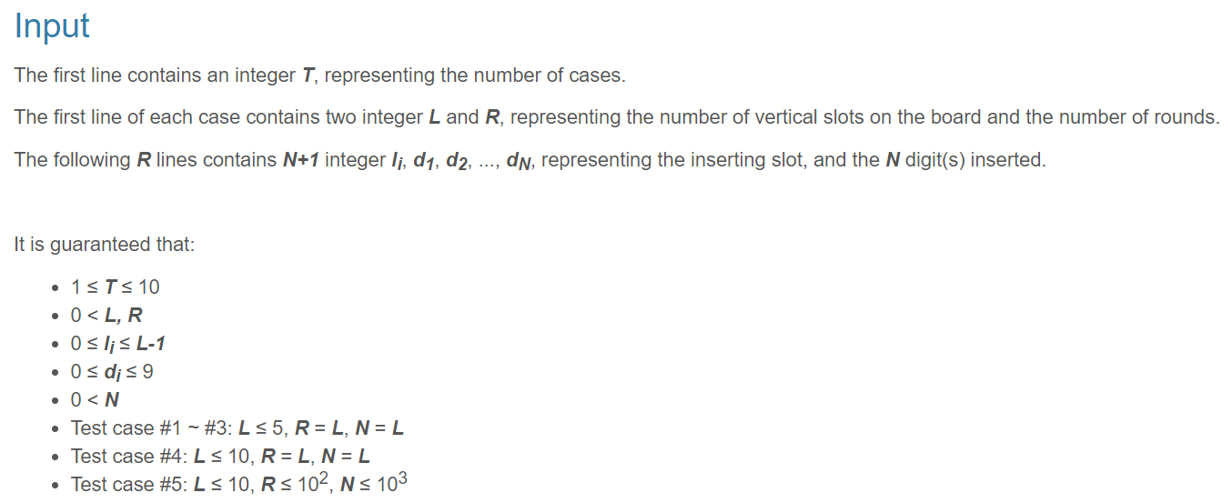
Caution!
In the worst case, the sum could be up to 9e12 at maximum.
In the 0th slot when there are 10 slots

Slide 6
Caution!
The int datatype can only store 32 bits binary number, from -2^32 to 2^32, that is, -2,147,483,648 to 2,147,483,647 ~ 2.1e9 in decimal.
Not enough for 9e12.
So we turn to long long int, this datatype can store 64 bits, 2^64 in decimal, approximately
9,223,372,036,854,775,807 ~ 9e18

Slide 7
Source codes in my github
https://reurl.cc/GdRAXW

